Slide 1

Task 1 UNIVERSITY OF BUEA Faculty Of Engineering and Technology
Internet Programming And Mobile Programming – CEF 440
By Dr. Nkemeni Valery
Group 16

Slide 2
Agenda
MOBILE APPLICATION PROGRAMMING LANGUAGES
INTRODUCTION
MAJOR TYPES OF MOBILE APPLICATION
01
02
03
Foundation of budgeting and its significance.
Comparing the 3 primary types of mobile applications.
Review And Comparison of Mobile Application
04
MOBILE APPLICATION DEVELOPMENT
FRAMEWORKS
05
06
MOBILE APPLICATION ARCHITACTURES
AND DESIGN PATTERNS
USER REQUIREMENTS FOR A MOBILE APPLICATION
Review And Comparison of Mobile Application Development Frameworks
Introduction to budgeting tools and apps.
How to collect and analyze user requirements for a mobile application
CONCLUSION
07
08
MOBILE APP DEVELOPMENT COST ESTIMATE
General Summary
How to estimate mobile app development cost

Slide 3

INTRODUCTION
01
This presentation explores the different types of mobile apps, their programming languages, frameworks, architectural patterns, and cost estimation practices.

Slide 4
MAJOR TYPES OF MOBILE APPLICATION
02
Native Applications
Progressive Web Applications
They are designed for a particular operating system, such as Android, iOS, or Windows.
Progressive Web Applications (PWAs) are web applications that provide a native-like experience through web technologies
Hybrid applications combine elements of both native and web apps. .
Hybrid Applications:

Slide 5
Comparison of Mobile App TypeS
Features | Native Apps | Progressive Web Apps | Hybrid Apps
Performance | High | Medium | Medium
Cost and Time to market | High | Low | Medium
Device Integration | Full | Limited | Partial
User Experience | Excellent | Moderate | Good
User Experience(UX) | Expensive | Low | Medium

Slide 6

MOBILE APPLICATION PROGRAMMING LANGUAGES 1/2
03
Java: Its robustness and performance make it a popular choice among developers. Widely used for building native Android applications.
Kotlin: It offers a more concise syntax and enhanced safety features compared to Java, thanks to its type inference capabilities.
Objective C: It combines high-level programming concepts with a Smalltalk-like syntax rooted in C.
Swift: It offers conciseness, safety, and high performance, making it a favourite among iOS developers.
Javascript(with React Native): Ideal for projects where code reuse and fast iteration are priorities.

Slide 7
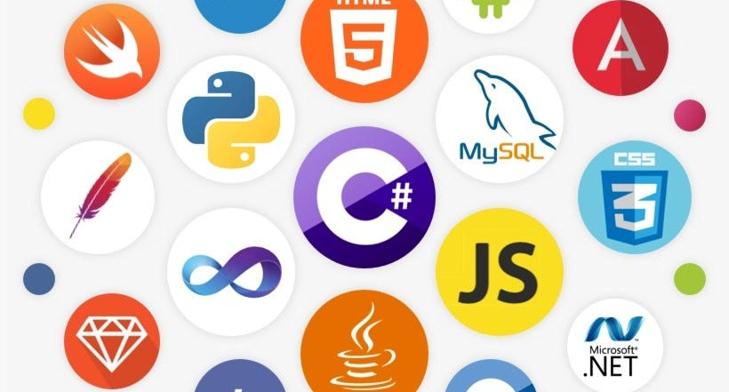
MOBILE APPLICATION PROGRAMMING LANGUAGES 2/2
Dart(with Flutter): It enables developers to create visually stunning and performant apps using a single codebase. Suitable for projects that require a high level of customization and smooth UI/UX.
C#(Xamarin): It is used with Microsoft's Xamarin framework.
C++: It is often used for performance-critical applications where speed is paramount. Commonly employed in gaming and graphics-intensive apps.
HTML5/CSS3/Javascript: This trio allows you to build hybrid apps that run within a web view. Ideal for projects with limited resources or tight budgets.

Slide 8
MOBILE APPLICATION DEVELOPMENT FRAMEWORKS
04
NativeScript: It allows developers to build truly native apps using JavaScript while accessing device features directly
React Native: Allows developers to build cross-platform apps using a single codebase while still achieving a near-native look and feel. Developed by Meta
Mobile Angular UI: Low cost, Quick development and moderate performance.
Flutter: It is known for fast performance and visually attractive user interfaces.
Xamarin: It allows code sharing across platforms and provides strong backend
Android SDK (Native Framework): Gives full control over Android devices and ensures optimal performance.
Ionic: It is easy for web developers to learn and is great for building lightweight apps quickly.
Intel XDK
Corona SDK: 2D games, interactive apps
Adobe Phone Gap: It wraps web apps into mobile apps.

Slide 9
MOBILE APPLICATION ARCHITACTURES AND DESIGN PATTERNS
05
Mobile apps are built on solid architectural foundations and follow specific design patterns to ensure they are maintainable, scalable, and user-friendly. Here’s a breakdown of the key ideas:

Slide 10
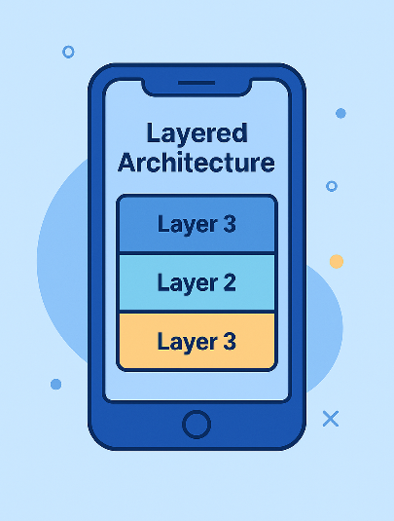
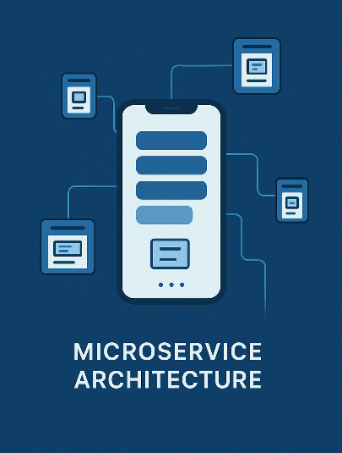
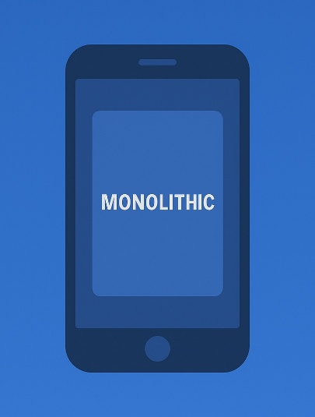
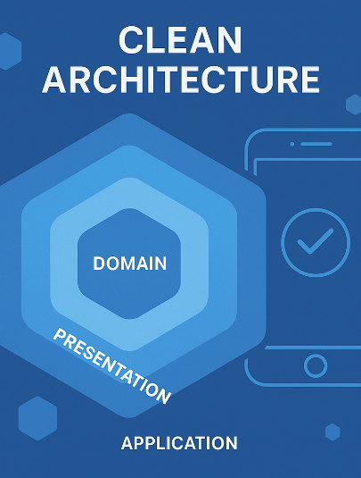
Architectural Styles
Microservice Architecture
Layered Architecture
Decompose an app into small, independent services that communicate over the network
This classic approach splits an app into distinct layers
Monolithic Architecture
Clean/Hexagonal/Onion Architectures
All components are tightly integrated into one single application.
These modern approaches emphasize separating the core business logic from external dependencies

Slide 11
Design Patterns for Mobile Development
Model-View-Presenter(MVP)
Model-View-ViewModel(MVVM)
Model-View-Controller(MVC)
This pattern is simple and widely used, particularly for smaller or less complex apps
MVP refines MVC by introducing a Presenter that acts as an intermediary between a “passive” View and the Model
MVVM introduces a ViewModel that binds data between the Model and the View
Singleton Method Design Pattern
Factory Method Design Pattern
View-Interactor-Presenter-Entity-Router
This policy ensures that there is only one instance of a class and provides global access.
It defines an interface for creating an object but allows subclasses to modify the type of the created object.
VIPER is designed for larger, more complex apps. It breaks down the application into five modules.

Slide 12

USER REQUIREMENTS FOR A MOBILE APPLICATION
06
Mobile app requirements documents the business logic, technical specifications, and development guidelines for mobile app developers to design the application of your business dreams. It includes the key app’s features, app user personas, and business goals to ensure that multiple team members are on the same page before the software development process commences.

Slide 13
Phases of Requirement Engineering(ER)
Requirement Discovery
Requirement Refinement & Categorization
Analysis Techniques
This phase involves uncovering what target users truly want from the mobile app.
Provide a detailed subitem that explains its focus and purpose clearly, offering concise insights.
Includes Journey Mapping, Decision trees, and feature prioritization messages
Requirement Verification
Structured Requirement Documentation
Before coding starts, requirements undergo validation checks.
Final requirements are compiled into shareable formats

Slide 14
Mobile Application Requirement Benefits
A better overall project development
Improved project management throughout the software development process
Enhanced efficiency to document the technical aspects required for an optimal product
A higher probability for the right target audience that meets the business requirements

Slide 15

MOBILE APP DEVELOPMENT COST ESTIMATE
07
When estimating the cost of developing a mobile app, some factors are considered:

Slide 16
Key Factors
3. Complexity
Define Requirements
2. Choose Platform
4. Design
5. Development Time
6. Testing
7. Maintainance
8. Contigency
10. Documentation and Support
9. Developer Rates
11. Marketing and Distribution

Slide 17
Cost Estimation In The Context of Cameroon
In Cameroon, development costs are generally lower due to reduced labor rates. With local hourly rates
around 10,000 Frs – 20,000 Frs per hour, overall project expenses can drop significantly compared to rates in more
developed markets.

Slide 18
Conclusion
08
By carefully selecting the appropriate app type, programming language, framework, and architecture, developers can build efficient and scalable applications

Slide 19

Thank You

